Slide 1
Chapter 6
Queues and Deques

Slide 2
Chapter Objectives
To learn how to represent a waiting line (queue) and how to use the functions in the Queue ADT for insertion (push), removal (pop), and for accessing the element at the front (front)
To understand how to implement the Queue ADT using a single-linked list, a circular array, and a double-linked list
To understand how to simulate the operation of a physical system that has one or more waiting lines using queues and random number generators
To introduce the standard library Deque class

Slide 3
Queues
The queue, like the stack, is a widely used data structure
A queue differs from a stack in one important way
a stack is LIFO list – Last-In, First-Out
while a queue is FIFO list, First-In, First-Out

Slide 4
The Queue Abstract Data Type
Section 6.1

Slide 5
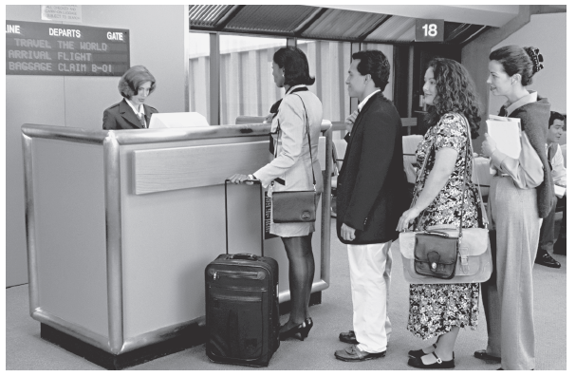
Queue Abstract Data Type
A queue can be visualized as a line of customers waiting for service
The next person to be served is the one who has waited the longest
New elements are placed at the end of the line

Slide 6
A Queue of Customers
To the left is a queue of three customers waiting to buy concert tickets
Ticket agent
Thome
Abreu
Jones

Slide 7
A Queue of Customers
To the left is a queue of three customers waiting to buy concert tickets
Ticket agent
Thome has been waiting the longest
Thome
Abreu
Jones

Slide 8
A Queue of Customers
To the left is a queue of three customers waiting to buy concert tickets
Ticket agent
Thome
Abreu
Jones
Jones is the most recent arrival

Slide 9
A Queue of Customers
To the left is a queue of three customers waiting to buy concert tickets
Ticket agent
Thome will be the first customer removed from the queue (and able to buy tickets) when a ticket agent becomes available
Thome
Abreu
Jones

Slide 10
A Queue of Customers
To the left is a queue of three customers waiting to buy concert tickets
Ticket agent
Thome
Abreu
Jones
Abreu will then become the first one in the queue

Slide 11
A Queue of Customers
To the left is a queue of three customers waiting to buy concert tickets
Ticket agent
Thome
Abreu
Jones
Any new customers will be inserted in the queue after Jones

Slide 12
Print Queue
Operating systems use queues to
keep track of tasks waiting for a scarce resource
ensure that the tasks are carried out in the order they were generated
Print queue: printing typically is much slower than the process of selecting pages to print, so a queue is used

Slide 13
Unsuitability of a “Print Stack”
Stacks are Last-In, First-Out (LIFO)
The most recently selected document would be the next to print
Unless the print stack is empty, your print job may never be executed if the printer is connected to a computer network and others are issuing print jobs

Slide 14
Specification for a Queue Interface
Because only the front element of a queue is visible, the operations performed by a queue are few in number
We need to be able to retrieve the front element, remove the front element, push a new element onto the queue, and test for an empty queue
The functions above are all defined in the header file for the STL container queue, <queue>

Slide 15
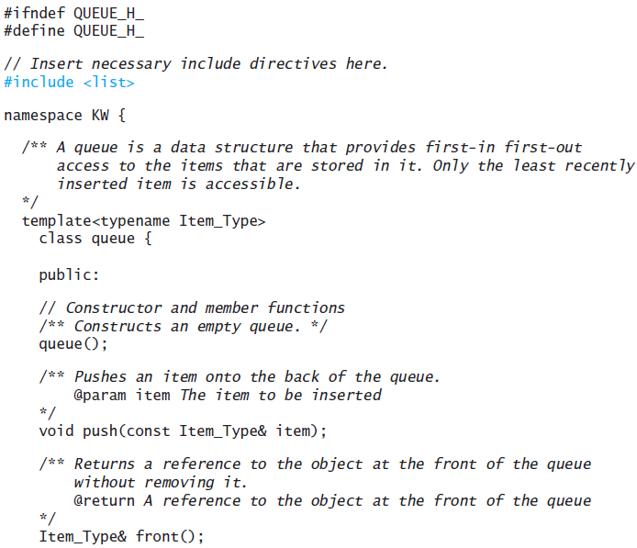
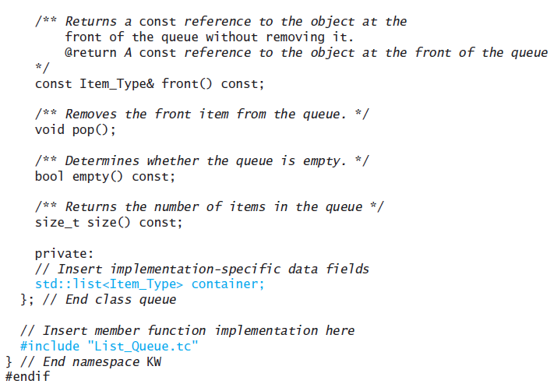
Specification for a Queue Interface (cont.)

Slide 16
Specification for a Queue Interface (cont.)
For queue names in (a), the value of names.empty() is false
The statement
string first = names.front();
stores "Jonathan" in first without changing names

Slide 17
Specification for a Queue Interface (cont.)
The statement
names.pop();
removes "Jonathan" from names. The queue names now contains four elements and is shown in (b)

Slide 18
Specification for a Queue Interface (cont.)
The statement
names.push("Eliana");
adds "Eliana" to the end of the queue; the queue names now contains five elements and is shown in (c)

Slide 19
Maintaining a Queue of Customers
Section 6.2

Slide 20
Maintaining a Queue of Customers
Write a menu-driven program that maintains a list of customers
The user should be able to:
insert a new customer in line
display the customer who is next in line
remove the customer who is next in line
display the length of the line

Slide 21
Analysis
Problem Inputs
The operation to be performed
The name of a customer (if needed for the operation)
Problem Outputs
The effect of each operation

Slide 22
Design
Write a program Maintain_Queue to store the queue and control its processing
Program Maintain_Queue has a queue<string> variable customers
Algorithm for main
while the user is not finished
Display the menu and get the selected operation
Perform the selected operation

Slide 23
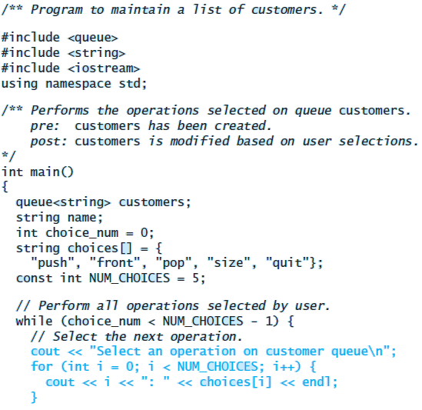
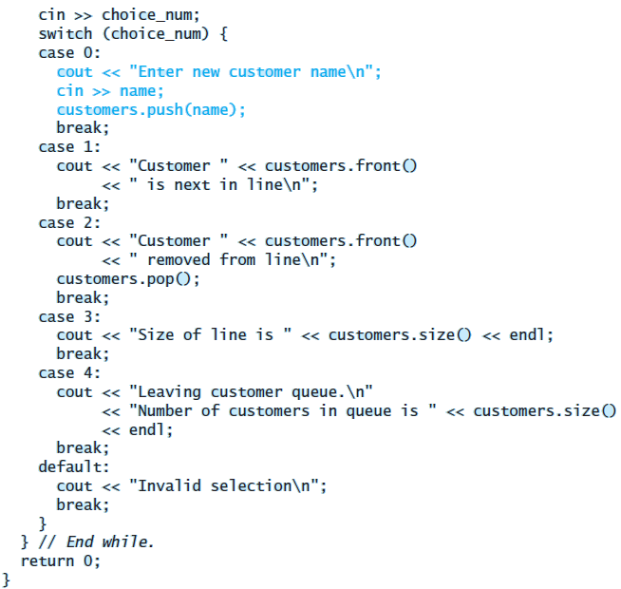
Implementation

Slide 24
Testing
You can use program Maintain_Queue to test each of the various queue implementations discussed in the next section
Verify that all customers are stored and retrieved in first-in, first-out order
Thoroughly test the queue by selecting different sequences of queue operations

Slide 25
Implementing the Queue ADT
Section 6.3

Slide 26
Using std::list as a Container for a Queue
The standard library defines the queue as a template class that takes any of the sequential containers as a template parameter
The sequential container list provides the push_back and pop_front functions

Slide 27
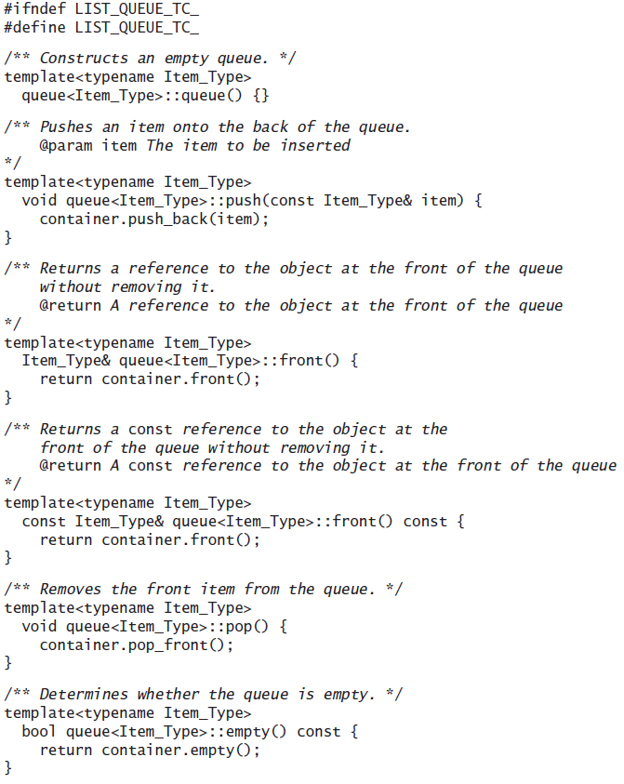
Using std::list as a Container for a Queue (cont.)

Slide 28
Using std::list as a Container for a Queue (cont.)
File List_Queue.tc would be included after the definition of class queue, at the end of queue.h
Like the stack class, the queue is said to be an adapter class because it adapts the functions available in another class to the interface its clients expect by giving different names to essentially the same operations
For example, if a list is used as the container object, queue::push would correspond to list::push_back and queue::front would correspond to list::front, and so on
This is called “delegation”

Slide 29
Using a Single-Linked List to Implement the Queue ADT
Insertions occur at the rear of a queue and removals occur at the front
We need a reference to the last list node so that insertions can be performed at O(1)
The number of elements in the queue is changed by methods push and pop

Slide 30
Using a Single-Linked List to Implement the Queue ADT (cont).
File queue.h needs to be modified
#include <cstddef> // defines NULL
…
private:
#include “Node.h”
Node* front_of_queue;
Node* back_of_queue;
…
#include “Linked_Queue.tc.”

Slide 31
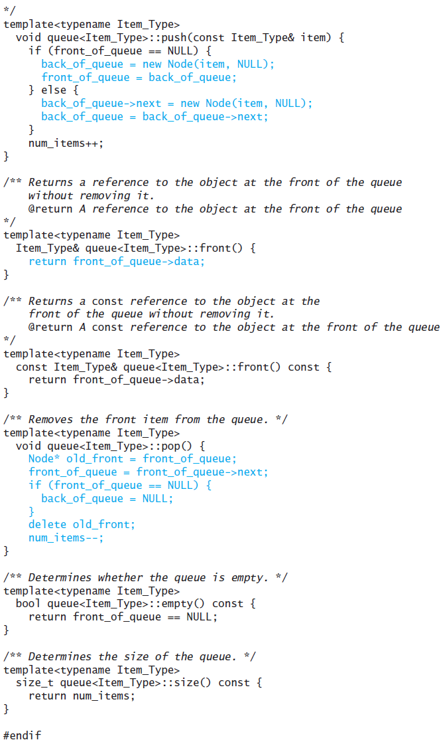
Using a Single-Linked List to Implement the Queue ADT (cont.)

Slide 32
Implementing a Queue Using a Circular Array
The time efficiency of using a single- or double-linked list to implement a queue is acceptable
However, there are some space inefficiencies
Storage space is increased when using a linked list due to references stored in the nodes
Array Implementation
Insertion at rear of array is constant time O(1)
Removal from the front is linear time O(n)
Removal from rear of array is constant time O(1)
Insertion at the front is linear time O(n)
We now discuss how to avoid these inefficiencies in an array

Slide 33
Overview of the Design
Array_Queue.tc uses an object with four size_t type data members
static const size_t DEFAULT_CAPACITY = 10;
size_t capacity;
size_t num_items;
size_t front_index;
size_t rear_index;
And a pointer to the data member, the_data to point to a dynamically-allocated array
Item Type* the_data;

Slide 34
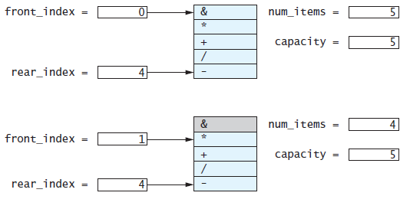
Overview of the Design – O(n) insertion

Slide 35
Overview of the Design – O(1) Insertion

Slide 36
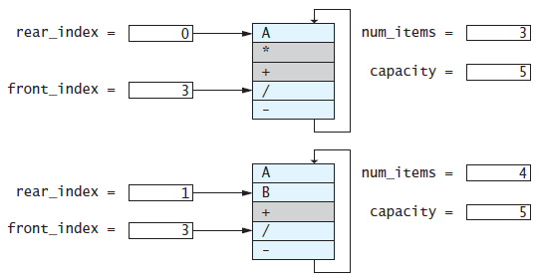
Overview of the Design – O(1) Insertion (cont.)

Slide 37
Implementing a Queue as a Circular Array (cont.)
front_index = 0
num_items = 0
capacity = 5
Template<typename Item_Type>
queue<Item_Type>::queue() :
capacity(DEFAULT_CAPACITY),
num_items(0),
front_index(0),
rear_index(DEFAULT_CAPACITY - 1),
the_data(new Item_Type[DEFAULT_CAPACITY]) {}
rear_index = 4

Slide 38
Implementing a Queue as a Circular Array (cont.)
push('*')
num_items = 0
front = 0
*
1
rear = 0
capacity = 5
template<typename Item_Type>
void queue<Item_Type> ::
push(const Item_Type& item) {
if (num_items == capacity) {
reallocate();
}
num_items++;
rear_index = (rear_index + 1) % capacity;
the_data[rear_index] = item;
}
rear = 4

Slide 39
Implementing a Queue as a Circular Array (cont.)
push('D');
B
num_items = 5
capacity = 5
rear_index = 1
+
C
front_index = 2
/
-
template<typename Item_Type>
void queue<Item_Type> ::
push(const Item_Type& item) {
if (num_items == capacity) {
reallocate();
}
num_items++;
rear_index = (rear_index + 1) % capacity;
the_data[rear_index] = item;
}
A

Slide 40
Implementing a Queue as a Circular Array (cont.)
the_data
B
push('D');
B
+
rear_index = 1
C
num_items = 5
front_index = 2
/
+
rear_index = 1
C
capacity = 5
-
front_index = 2
/
A
-
template<typename Item_type>
void queue<Item_Type>::reallocate() {
size_t new_capacity = 2 * capacity;
Item_Type* new_data = new Item_Type[new_capacity];
size_t j = front_index;
for (size_t i = 0; i < num_items; i++) {
new_data[i] = the_data[j];
j = (j + 1) % capacity;
}
front_index = 0;
rear_index = num_items – 1;
capacity = new_capacity;
std::swap(the_data, new_data);
delete[] new_data;
}
A
new_capacity = 10

Slide 41
Implementing a Queue as a Circular Array (cont.)
new_data
the_data
i = 0
B
B
push('D');
+
+
C
rear_index = 1
C
num_items = 5
front_index = 2
/
j = 2
/
capacity = 5
-
-
A
A
template<typename Item_type>
void queue<Item_Type>::reallocate() {
size_t new_capacity = 2 * capacity;
Item_Type* new_data = new Item_Type[new_capacity];
size_t j = front_index;
for (size_t i = 0; i < num_items; i++) {
new_data[i] = the_data[j];
j = (j + 1) % capacity;
}
front_index = 0;
rear_index = num_items – 1;
capacity = new_capacity;
std::swap(the_data, new_data);
delete[] new_data;
}
new_capacity = 10

Slide 42
Implementing a Queue as a Circular Array (cont.)
the_data
new_data
front_index = 0
the_data
new_data
rear_index = 4
i = 0
/
B
j = 0
B
/
B
push('D');
+
j = 1
+
C
C
-
rear_index = 1
C
i = 1
rear_index = 1
num_items = 5
front_index = 2
/
j = 2
/
i = 2
A
/
capacity = 5
10
-
j = 3
-
-
i = 3
B
A
j = 4
A
A
i = 4
C
template<typename Item_type>
void queue<Item_Type>::reallocate() {
size_t new_capacity = 2 * capacity;
Item_Type* new_data = new Item_Type[new_capacity];
size_t j = front_index;
for (size_t i = 0; i < num_items; i++) {
new_data[i] = the_data[j];
j = (j + 1) % capacity;
}
front_index = 0;
rear_index = num_items – 1;
capacity = new_capacity;
std::swap(the_data, new_data);
delete[] new_data;
}
i = 5
new_capacity = 10

Slide 43
Implementing a Queue as a Circular Array (cont.)
the_data
new_data
front_index = 0
rear_index = 4
/
/
push('D');
-
rear_index = 1
num_items = 5
j = 2
A
capacity = 5
10
B
C
template<typename Item_type>
void queue<Item_Type>::reallocate() {
size_t new_capacity = 2 * capacity;
Item_Type* new_data = new Item_Type[new_capacity];
size_t j = front_index;
for (size_t i = 0; i < num_items; i++) {
new_data[i] = the_data[j];
j = (j + 1) % capacity;
}
front_index = 0;
rear_index = num_items – 1;
capacity = new_capacity;
std::swap(the_data, new_data);
delete[] new_data;
}
i = 5
new_capacity = 10

Slide 44
Implementing a Queue as a Circular Array (cont.)
the_data
new_data
front_index = 0
rear_index = 4
5
/
/
push('D');
-
num_items = 5
6
A
capacity = 5
10
B
C
D
template<typename Item_Type>
void queue<Item_Type> ::
push(const Item_Type& item) {
if (num_items == capacity) {
reallocate();
}
num_items++;
rear_index = (rear_index + 1) % capacity;
the_data[rear_index] = item;
}

Slide 45
Implementing a Queue as a Circular Array (cont.)
By choosing a new capacity that is twice the current capacity, the cost of the reallocation is amortized across each insert, just as for a vector
Thus, insertion is still considered an O(1) operation

Slide 46
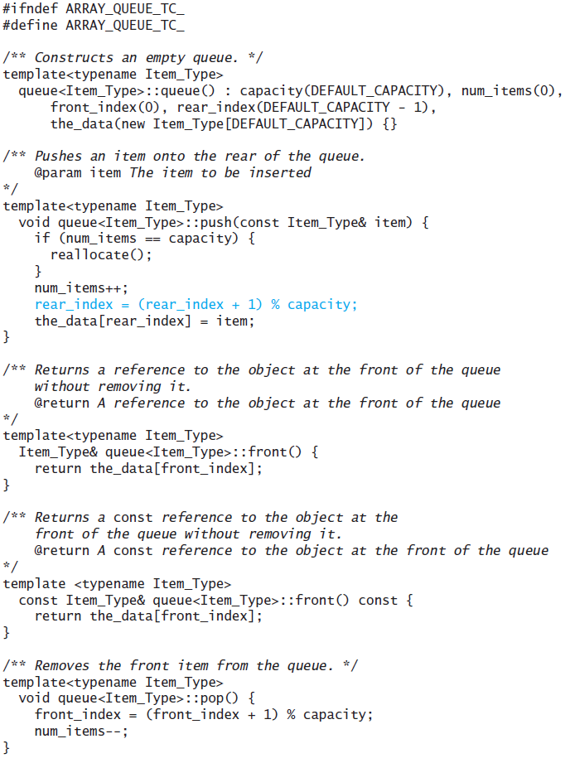
Implementing a Queue as a Circular Array (cont.)

Slide 47
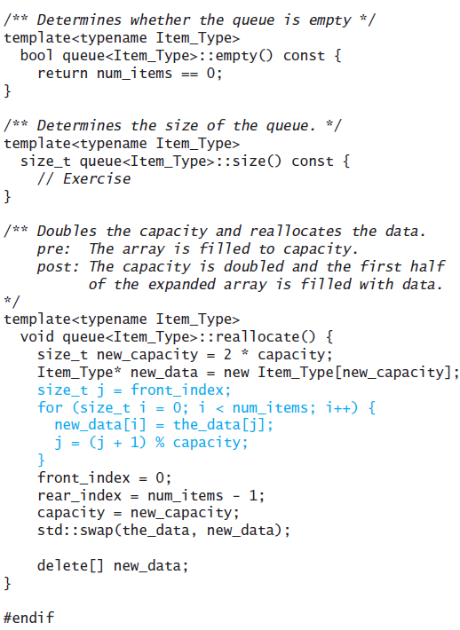
Implementing a Queue as a Circular Array (cont.)

Slide 48
Comparing the Three Implementations
All three implementations of the Queue ADT are O(1)
Although reallocating an array is an O(n) operation, it is amortized over n items, so the cost per item is O(1)
Both linked-list implementations require more storage because extra space is required for links

Slide 49
Comparing the Three Implementations (cont.)
C++ stores a copy of the data for a queue element in each node in addition to the links
a node in a single linked list stores a total of one pointer
a node in a double-linked list stores a total of two pointers
a node in a circular array stores just the data
A circular array that is filled to capacity requires half the storage of a single linked list to store the same number of elements (assuming that the data type requires the same amount of storage as a pointer)
However, if the array were just reallocated, half the array would be empty, so it would require the same storage as a single-linked list

Slide 50
The Deque
Section 6.4

Slide 51
Deque Interface
A deque (typically pronounced "deck") is short for “double-ended queue”
A double-ended queue allows you to insert, access, and remove items from either end
The C++ standard library takes this concept further and defines the class std::deque to be a sequence that, like the vector, supports random-access iterators (not supported by either the stack or the queue) in addition to constant-time insertion and removal from either end

Slide 52
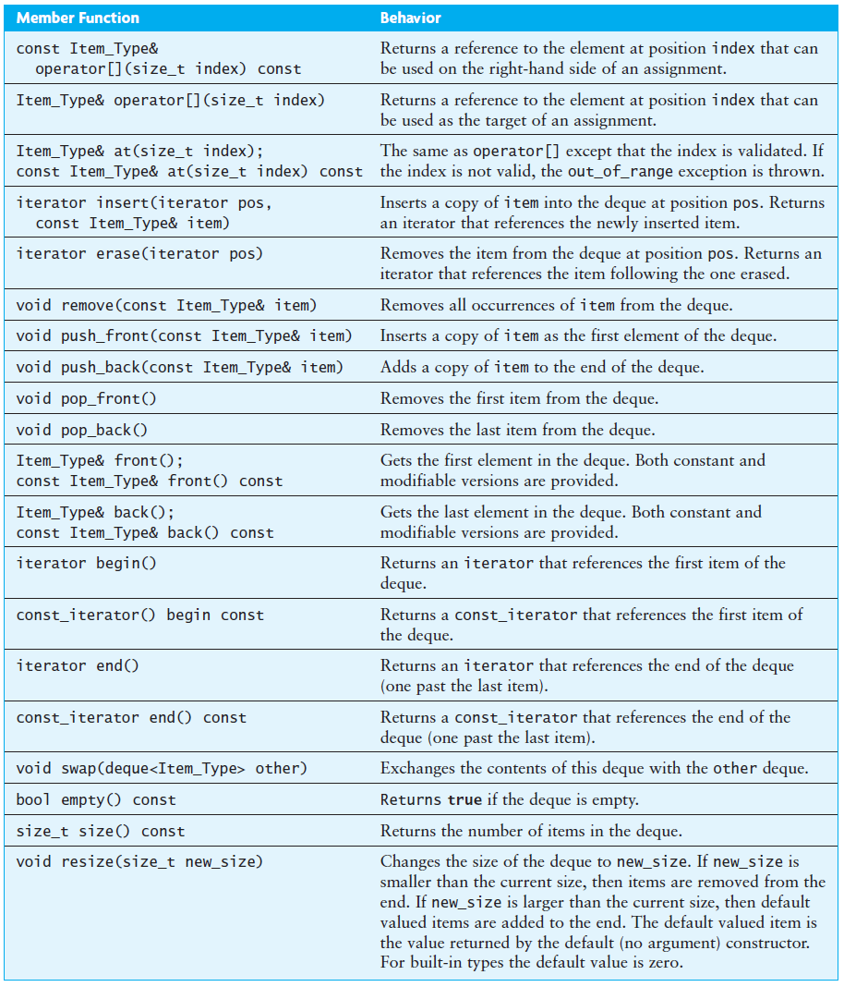
Specification of the Deque

Slide 53
Implementing the Deque Using a Circular Array
Earlier we showed how to use a circular array to implement a queue
We showed how to implement the functions
queue::push (equivalent to deque::push_back)
queue::pop (equivalent to deque::pop_front)
Implementing functions push_front and pop_back is similar and is left as an exercise

Slide 54
Implementing the Deque Using a Circular Array (cont.)
To obtain random access,
consider that the ith element is at position front_index + i, assuming that i starts at 0 and this sum is not larger than capacity
if it is larger than capacity, we need to wrap around the end of the array using modulo arithmetic
The implementation of the index operator is:
/** Returns a reference to an item in the deque based on an index. */
Item_Type& operator[](size_t i) {
return the_data[(i + front_index) % capacity];
}

Slide 55
Implementing the Deque Using a Circular Array (cont.)
Implementation of the remaining deque functions is left as a programming project
A randomly accessible circular array is part of the standard deque implementation
Thus, we will refer to this implementation of the deque as the class CArray

Slide 56
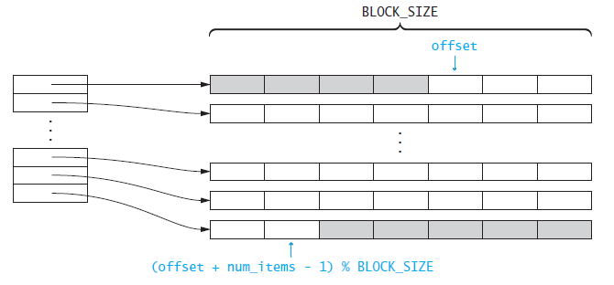
The Standard Library Implementation of the Deque
The standard library implementation circular array contains pointers to fixed-size, dynamically allocated arrays that contain the data
The first data item is located at offset
The last data item is located at index (offset + num_items – 1) % BLOCK_SIZE in the last data block

Slide 57
The Standard Library Implementation of the Deque (cont.)
The original designers chose this rather elaborate implementation rather than simply using a circular array because of the cost of reallocation
Even though we amortize the cost of the reallocation so that each push_front or push_back is a constant-time operation, the reallocation can take a significant amount of time
By storing only pointers in the circular array, the cost of reallocation is significantly reduced, because copying a pointer is a simple operation
Storing pointers to single objects in the circular array could work, but dynamically allocating small objects has a significant space overhead
Thus, by allocating an array of objects, we minimize this space overhead and minimize the cost of the reallocation
For large collections of large objects, the deque can be used instead of the vector to minimize space overhead and the cost of reallocation

Slide 58
The Data Fields for the Deque

Slide 59
The Index Operator
/** Returns a reference to an item referenced by an index.
@param i the index
@return A reference to deque[i]
*/
template<typename Item_Type>
Item_Type& deque<Item_Type>::operator[](size_t i) {
if (i >= num_items)
throw std::out_of_range
("Invalid index to deque::operator[]");
size_t block_index = (offset + i) / BLOCK_SIZE;
size_t data_index = (offset + i) % BLOCK_SIZE;
return the_data[block_index][data_index];
}

Slide 60
The push_back Function
/** Pushes an item onto the back of the deque.
@param item The item to be inserted.
*/
template<typename Item_Type>
void deque<Item_Type>::push_back(const Item_Type& item) {
size_t capacity = the_data.size() * BLOCK_SIZE;
// Determine if the capacity needs to be increased.
if ((num_items + offset) == capacity) {
the_data.push_back(new Item_Type[BLOCK_SIZE]);
}
num_items++;
(*this)[num_items - 1] = item;
}

Slide 61
The pop_front Function
/** Removes the front item from the deque. */
template<typename Item_Type>
void deque<Item_Type>::pop_front() {
offset++;
if (offset == BLOCK_SIZE) {
delete[] the_data.front();
the_data.pop_front();
offset = 0;
}
num_items--;
}

Slide 62
Simulating Waiting Lines Using Queues
Section 6.5

Slide 63
Simulating Waiting Lines Using Queues
Simulation is used to study the performance of a physical system by using a physical, mathematical, or computer model of the system
Simulation allows designers of a new system to estimate the expected performance before building it
Simulation can lead to changes in the design that will improve the expected performance of the new system
Simulation is useful when the real system would be too expensive to build or too dangerous to experiment with after its construction

Slide 64
Simulating Waiting Lines Using Queues (cont.)
System designers often use computer models to simulate physical systems
Example: an airline check-in counter
A branch of mathematics called queuing theory studies such problems

Slide 65
Case Study
Blue Skies Airlines (BSA) would like to have two waiting lines:
regular customers
frequent flyers
Assuming only one ticket agent, BSA would like to determine the average wait time for taking passengers from the waiting lines using various strategies:
take turns serving passengers from both lines (one frequent flyer, one regular, one frequent flyer, etc.)
serve the passenger waiting the longest
serve any frequent flyers before serving regular passengers

Slide 66
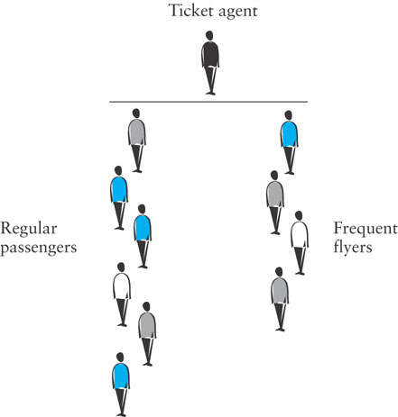
Case Study (cont.)

Slide 67
Case Study: Analysis
To run the simulation, we must keep track of the current time by maintaining a clock set to an initial time of zero
The clock will increase by one time unit until the simulation is finished
During each time interval, one or more of the following events occur(s):
a new frequent flyer arrives in line
a new regular flyer arrives in line
the ticket agent finishes serving a passenger and begins to serve a passenger from the frequent flyer line
the ticket agent finishes serving a passenger and begins to serve a passenger from the regular passenger line
the ticket agent is idle because there are no passengers to serve

Slide 68
Case Study: Analysis (cont.)
We can simulate different serving strategies by introducing a simulation variable, frequent_flyer_max (> 0)
frequent_flyer_max represents the number of consecutive frequent flyer passengers served between regular passengers
When frequent_flyer_max is:
1, every other passenger served will be a regular passenger
2, every third passenger served will be a regular passenger
a very large number, any frequent flyers will be served before regular passengers

Slide 69
Case Study: Design (cont.)

Slide 70
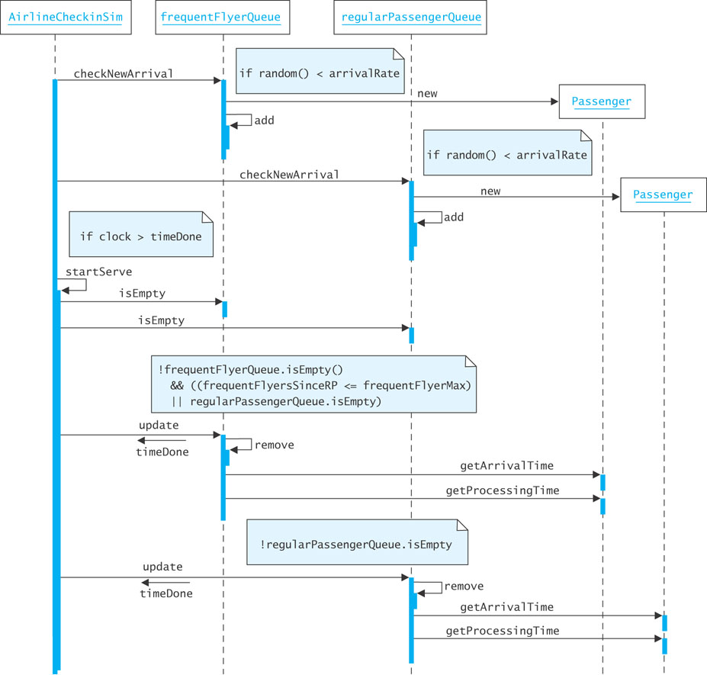
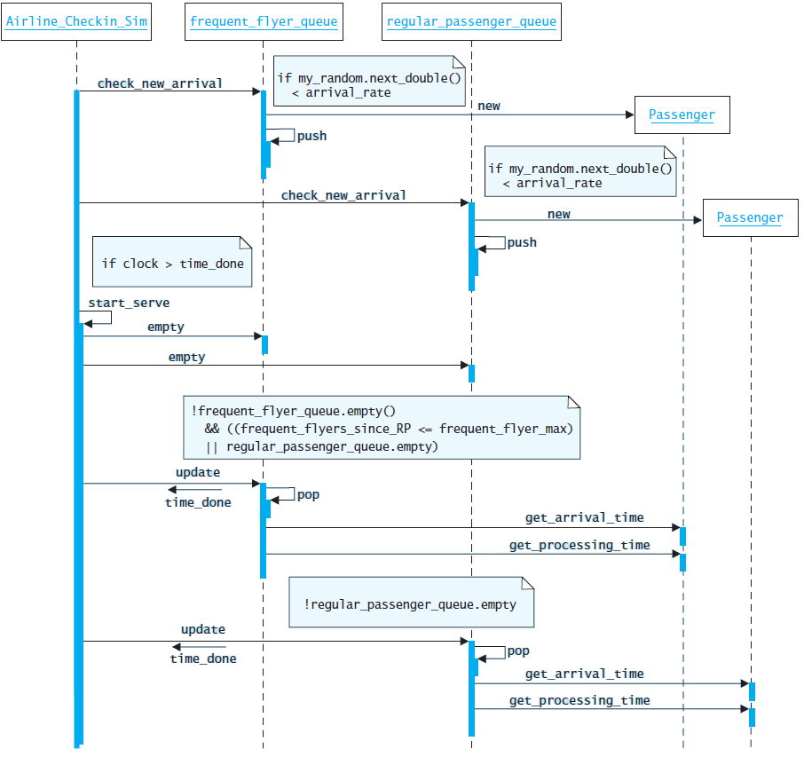
Case Study: Design (cont.)

Slide 71
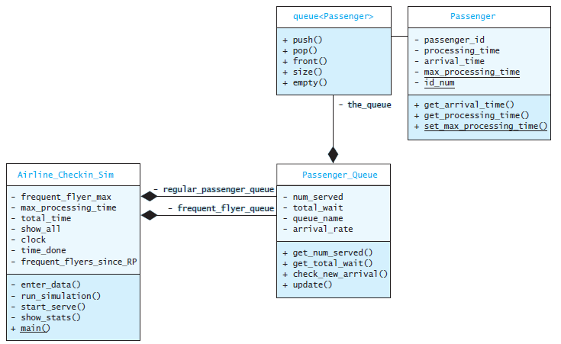
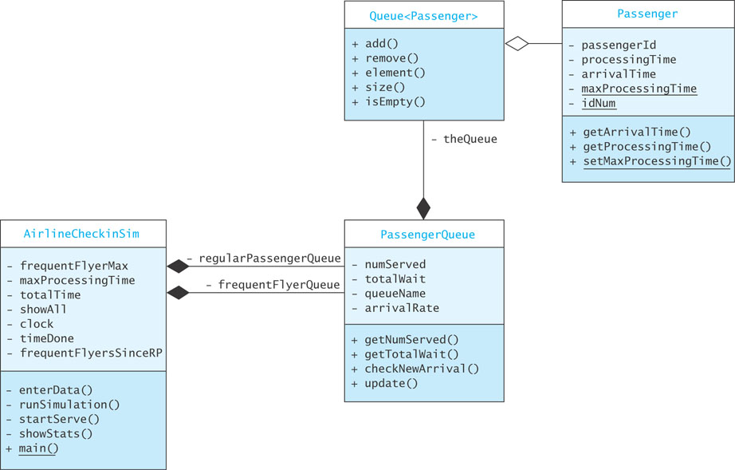
Case Study: Design (cont.)

Slide 72
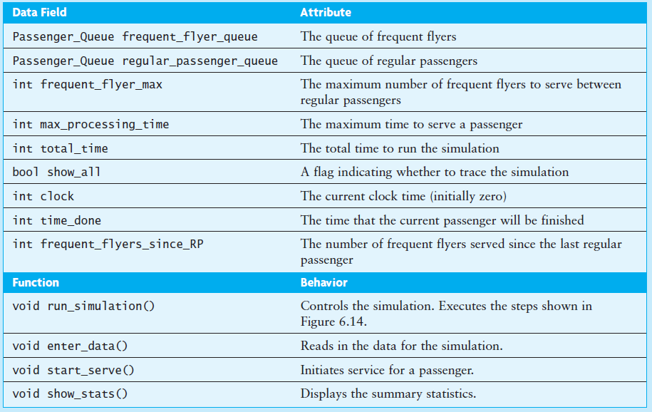
Case Study: Design (cont.)

Slide 73
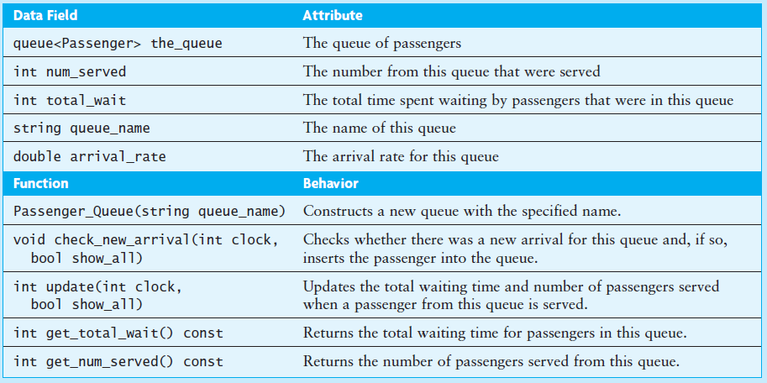
Case Study: Design (cont.)

Slide 74
Case Study: Design (cont.)

Slide 75
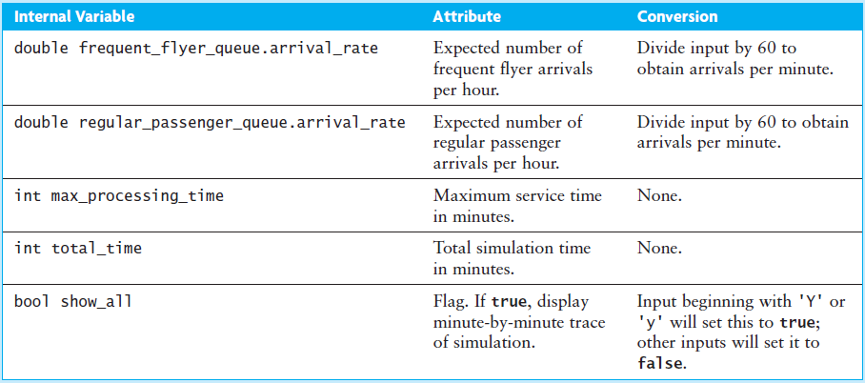
Case Study: Implementation

Slide 76
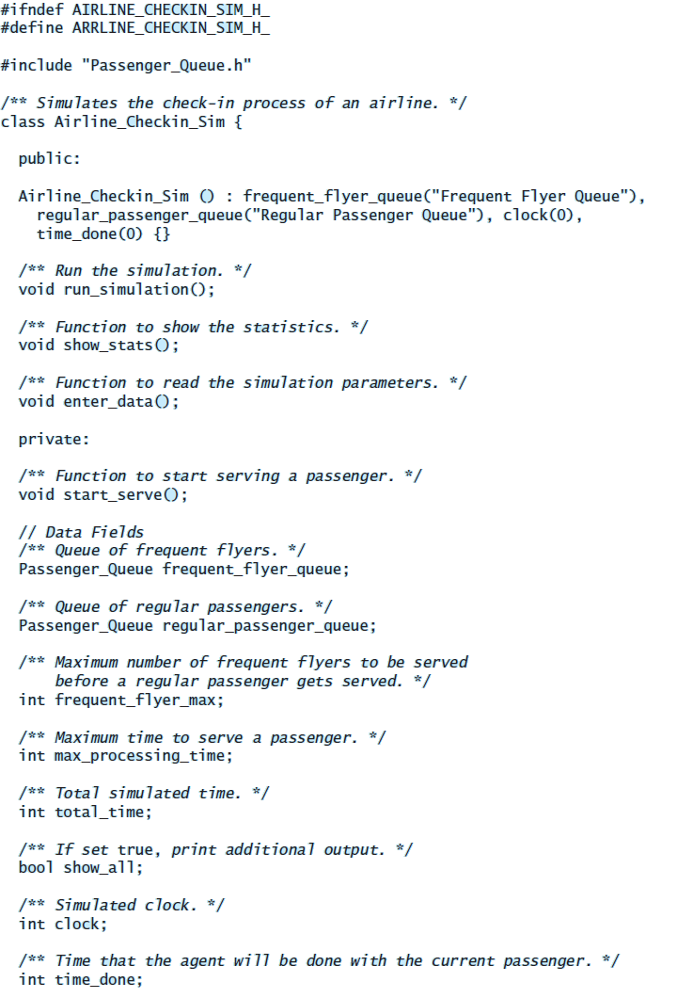
Case Study: Implementation

Slide 77
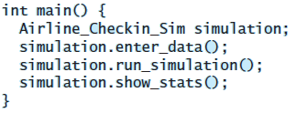
Case Study: Implementation (cont.)

Slide 78
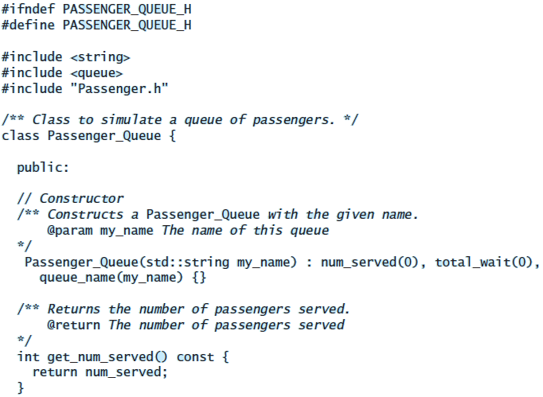
Case Study: Implementation (cont.)

Slide 79
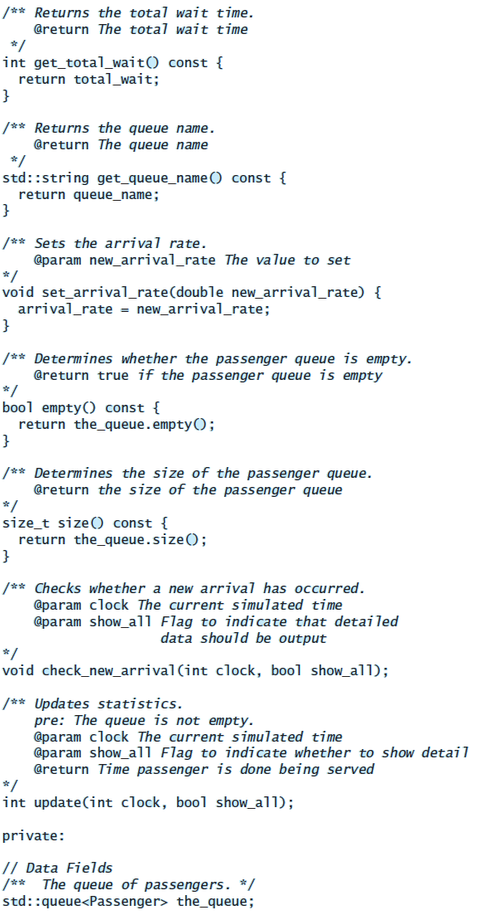
Case Study: Implementation (cont.)

Slide 80
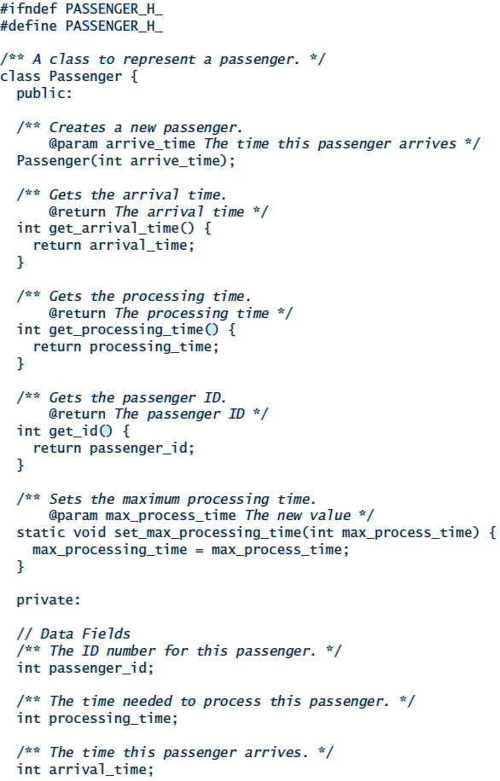
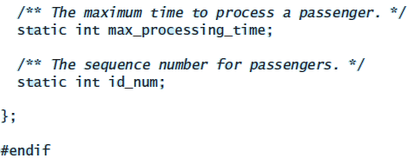
Case Study: Implementation (cont.)

Slide 81
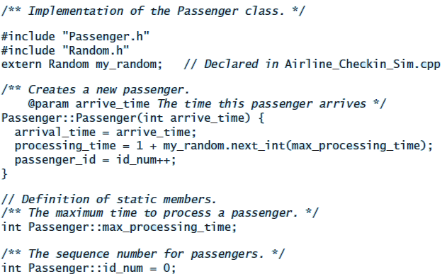
Case Study: Implementation (cont.)

Slide 82
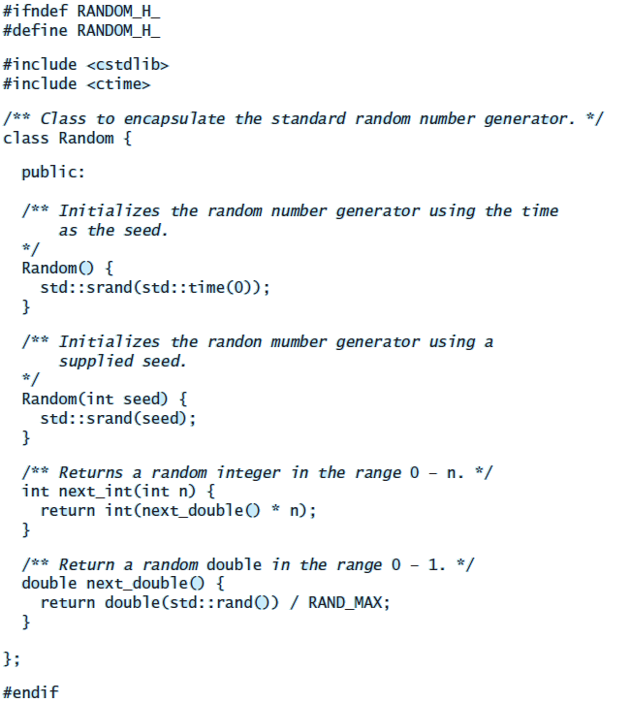
Case Study: Implementation (cont.)

Slide 83
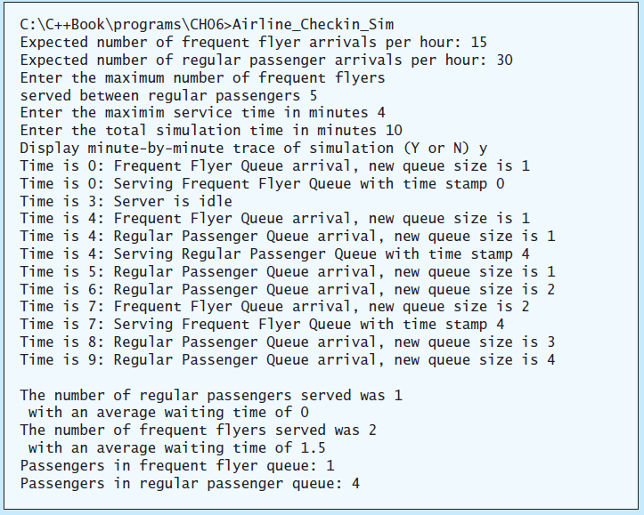
Case Study: Testing

